Slide 1




Slide 2
Question Answering systems using transformers
Notes:
Hello and welcome, in this video we will start to dive into the components of the internal structure of transformers.

Slide 3



Introduction
Question answering systems are systems that can automatically answer questions that are posed by humans in natural language.
Question Answering Apps:

Slide 4
What will we discuss in this chapter?
What are the different types of question-answering systems and how do they work?
What are the different methods for building question answering systems and what are their advantages and disadvantages?
How can we use transformers to build question-answering systems for different types of data, such as text, tables, and images?
How to fine-tune a pretrained transformer model for our custom dataset?

Slide 5
Question answering systems Types
Question answering systems
Data source
Answer format
Open domain QA
Closed domain QA
Extractive QA
Knowledge-based QA
Generative QA

Slide 6
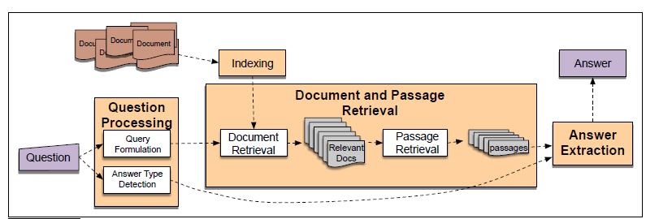
Extractive QA
Also known as Information retrieval-based QA
Extracting the answer directly from a given passage or document without generating any new text.
Identifies the relevant passages or sentences from the text that contain the answer.
Use for fact-based questions that require a specific answer.
https://rainynotes.net/QA-System-Note/

Slide 7
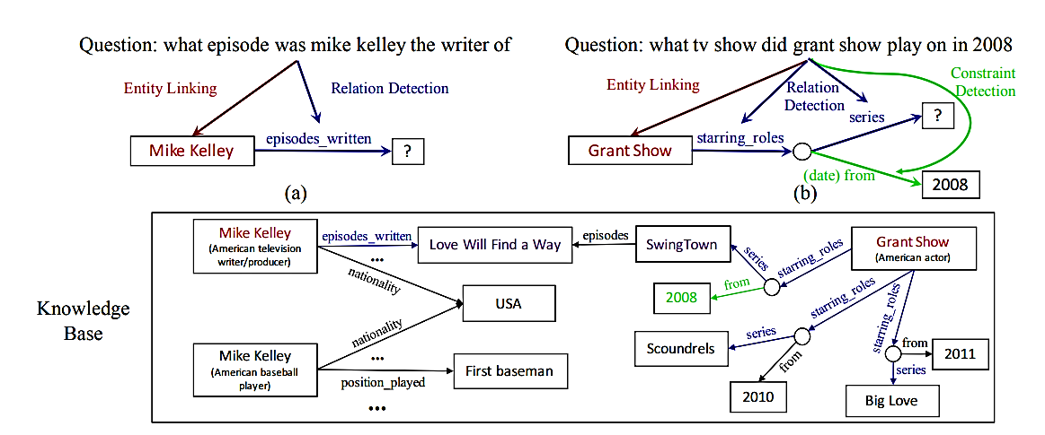
Knowledge-based QA
Uses a structured database of knowledge or information
Returns an abstractive answer, which is a natural language sentence that summarizes the answer.
For example:
https://www.researchgate.net/publication/318740438_Improved_Neural_Relation_Detection_for_Knowledge_Base_Question_Answering

Slide 8
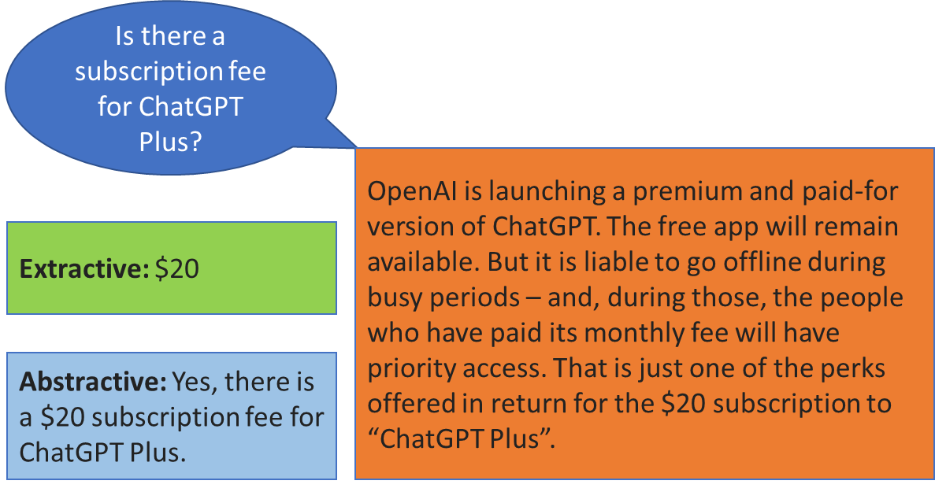
Generative QA
Also called Abstractive QA.
Generative QA models are typically based on deep learning techniques such as transformer models like BERT and GPT.
These models are trained on large amounts of text data and can generate coherent and contextually relevant answers to a wide range of questions.
https://towardsdatascience.com/extractive-vs-generative-q-a-which-is-better-for-your-business-5a8a1faab59a

Slide 9
Generative QA
The system analyzes the question and then generates a response that is grammatically correct and logically sound.
Generative QA advantages:
Provide answers to questions that are not covered in pre-existing databases or knowledge bases.
Generate answers that are more natural-sounding and human-like than those produced by retrieval-based models.
Generative QA disadvantages:
More computationally expensive and require more training data than retrieval-based models.
https://towardsdatascience.com/extractive-vs-generative-q-a-which-is-better-for-your-business-5a8a1faab59a

Slide 10
Question answering systems Types
Question answering systems
Data source
Answer format
Open domain QA
Closed domain QA
Extractive QA
Knowledge-based QA
Generative QA

Slide 11
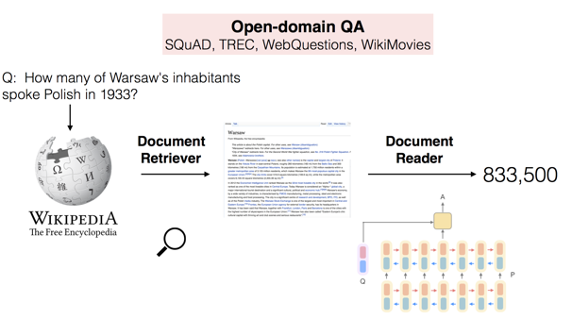
Open domain QA systems
Designed to answer any type of question, regardless of the domain or topic.
Use natural language processing (NLP) techniques to understand the meaning of a question and search through a vast amount of data to find relevant information that can answer the question.
Used for general information retrieval tasks, such as answering trivia questions or providing answers to common queries.
http://ai.stanford.edu/blog/answering-complex-questions/

Slide 12
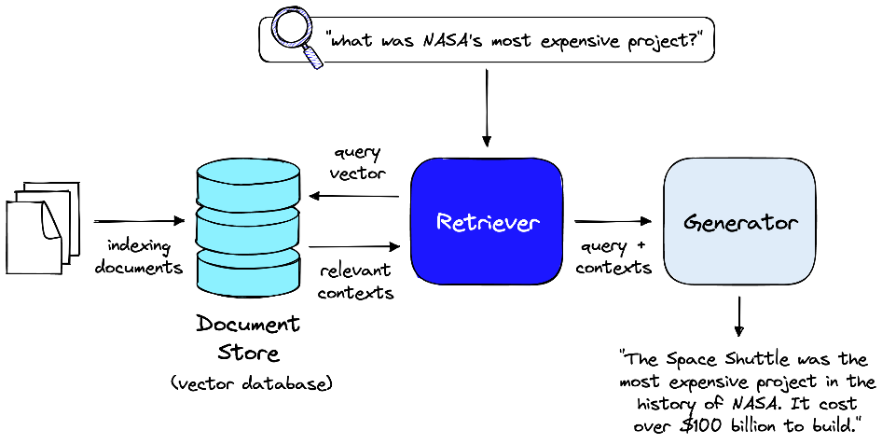
Closed domain QA systems
Designed to answer questions within a specific domain or topic.
Trained on a limited set of data related to the specific domain, such as medical or legal information.
This allows them to provide more accurate and relevant answers to questions related to that domain.
Used in specialized fields where accuracy and precision are critical.
https://www.pinecone.io/learn/openai-gen-qa/

Slide 13
How to Build Question answering systems ?
Question answering systems
Building Methods
Rule-based
Method
Statistical Methods
Deep Learning Methods

Slide 14
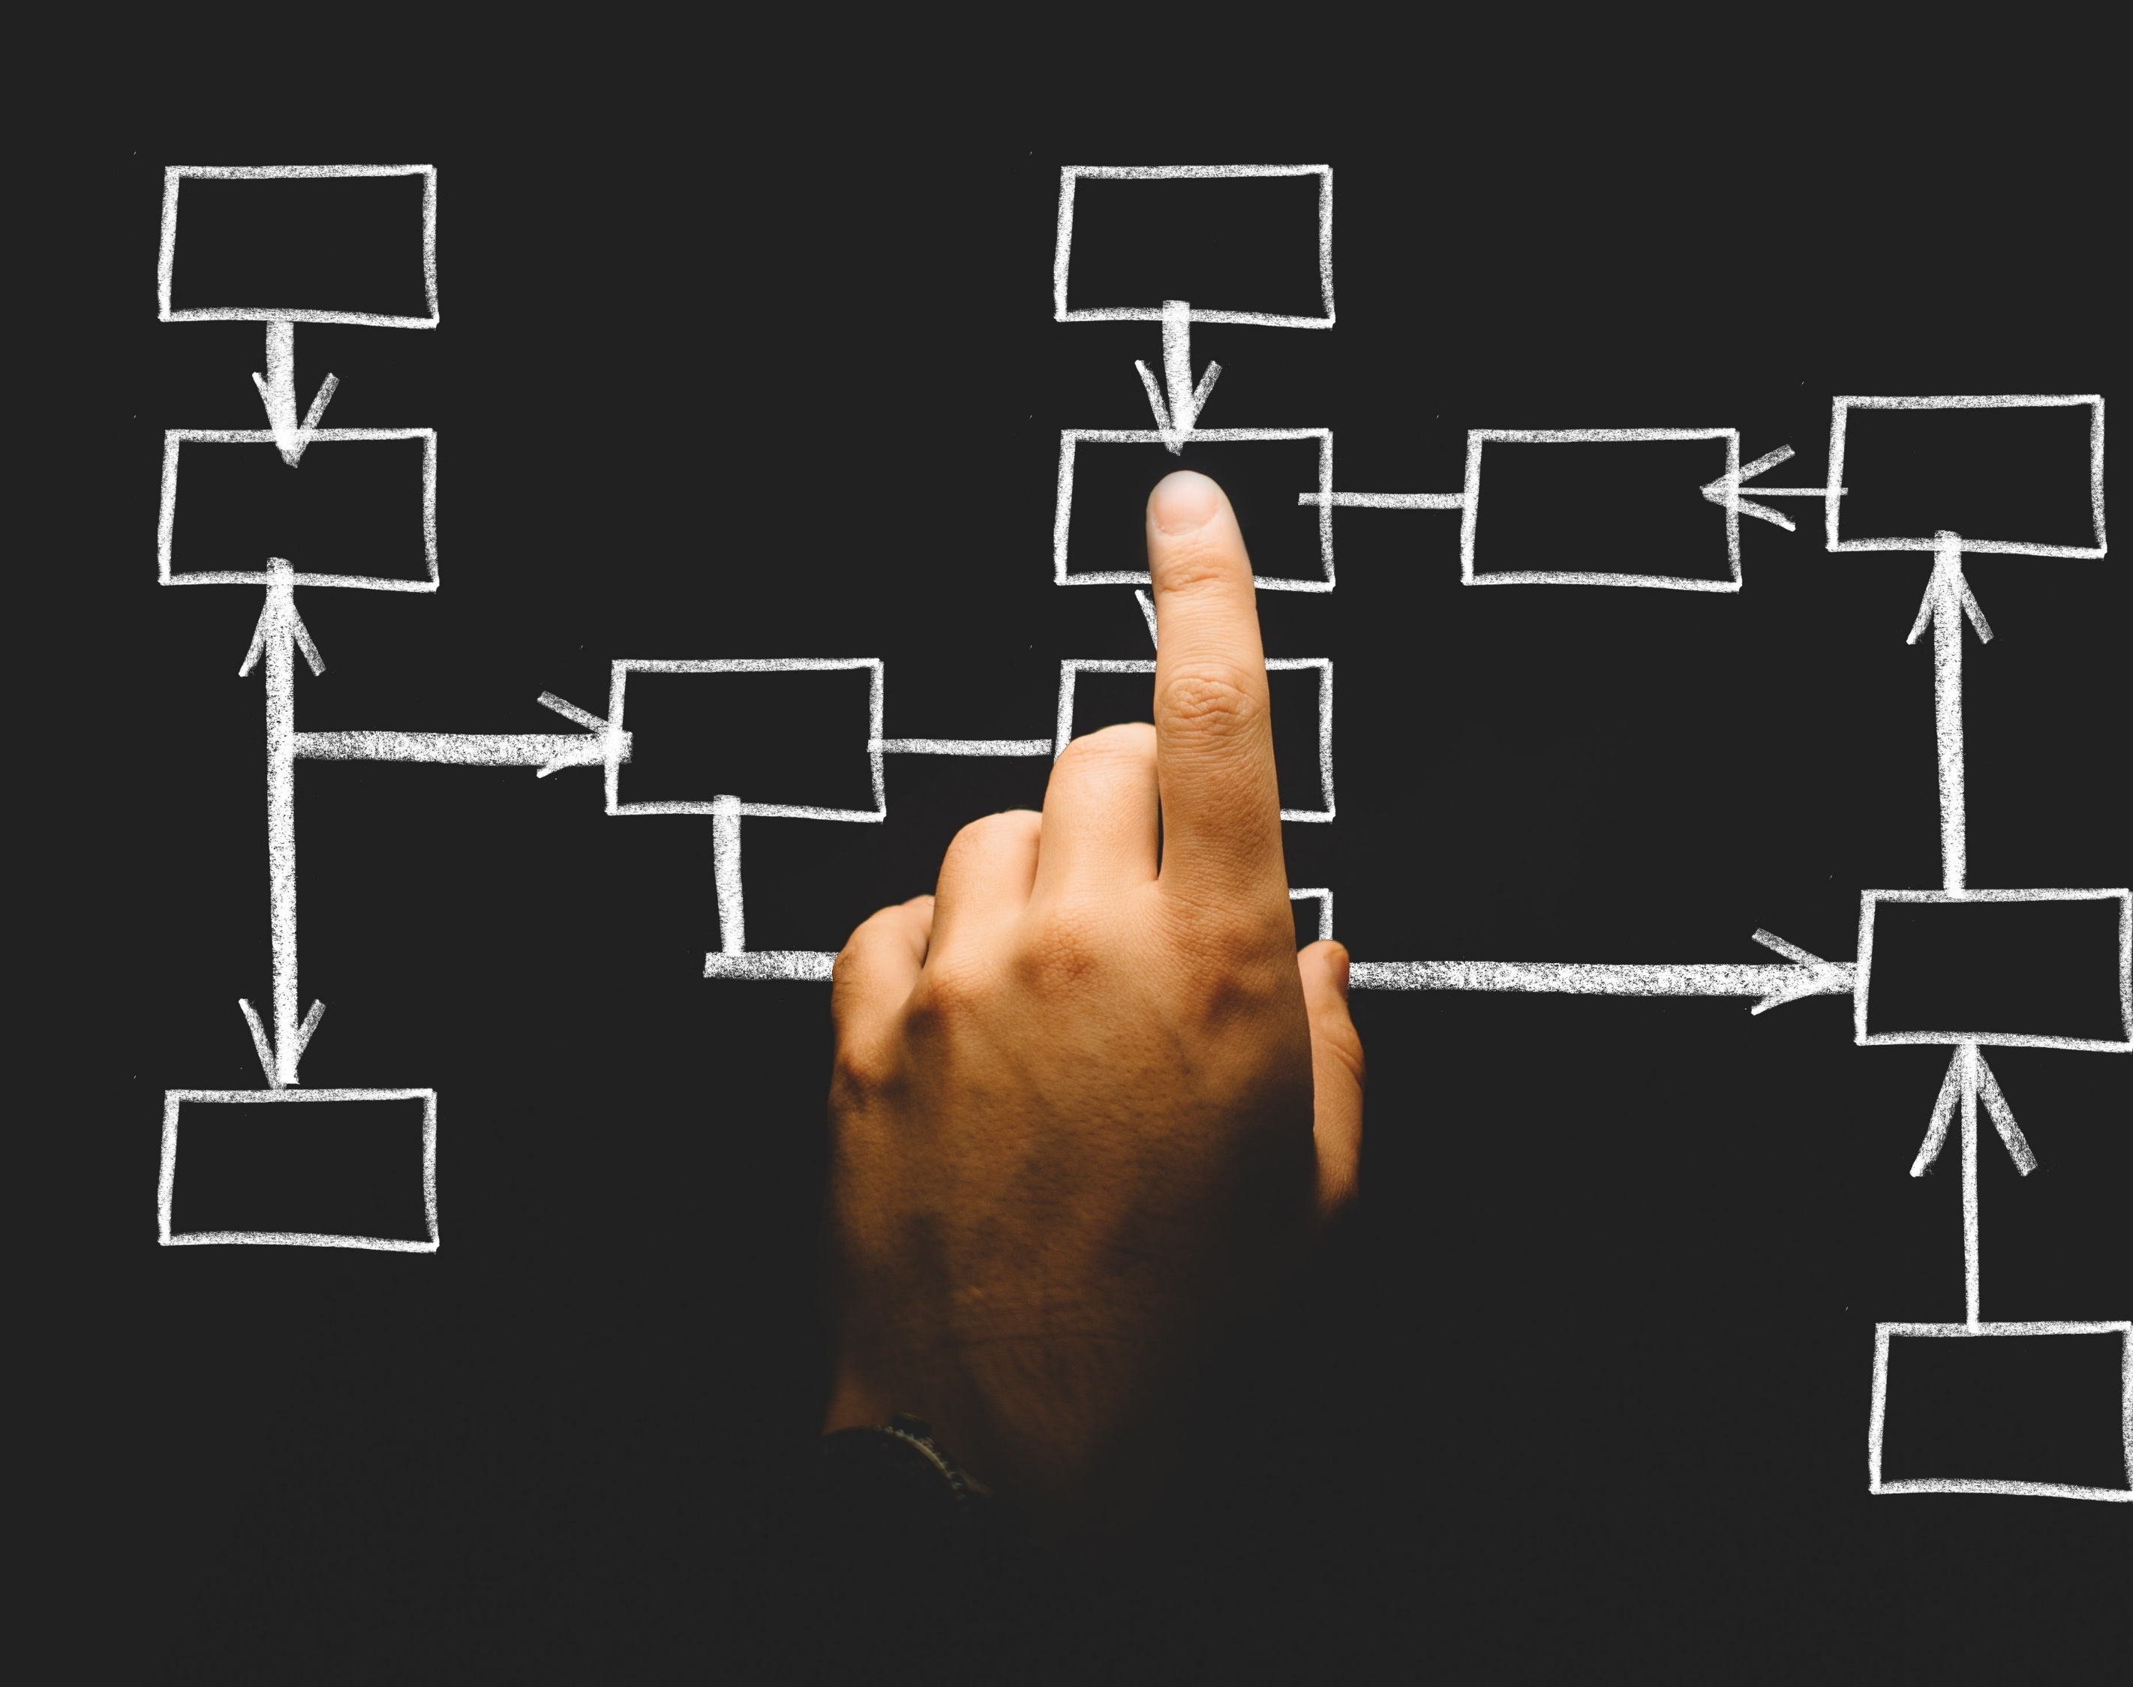
Rule-based methods
These methods use a set of rules to match the question with the answer.
For example:
The question: “Who is the president of the United States?”
System rule: “The president of the United States is X”
Rule-based methods:
Simple and easy to implement
limited by the quality and completeness of the rules and the knowledge base.

Slide 15
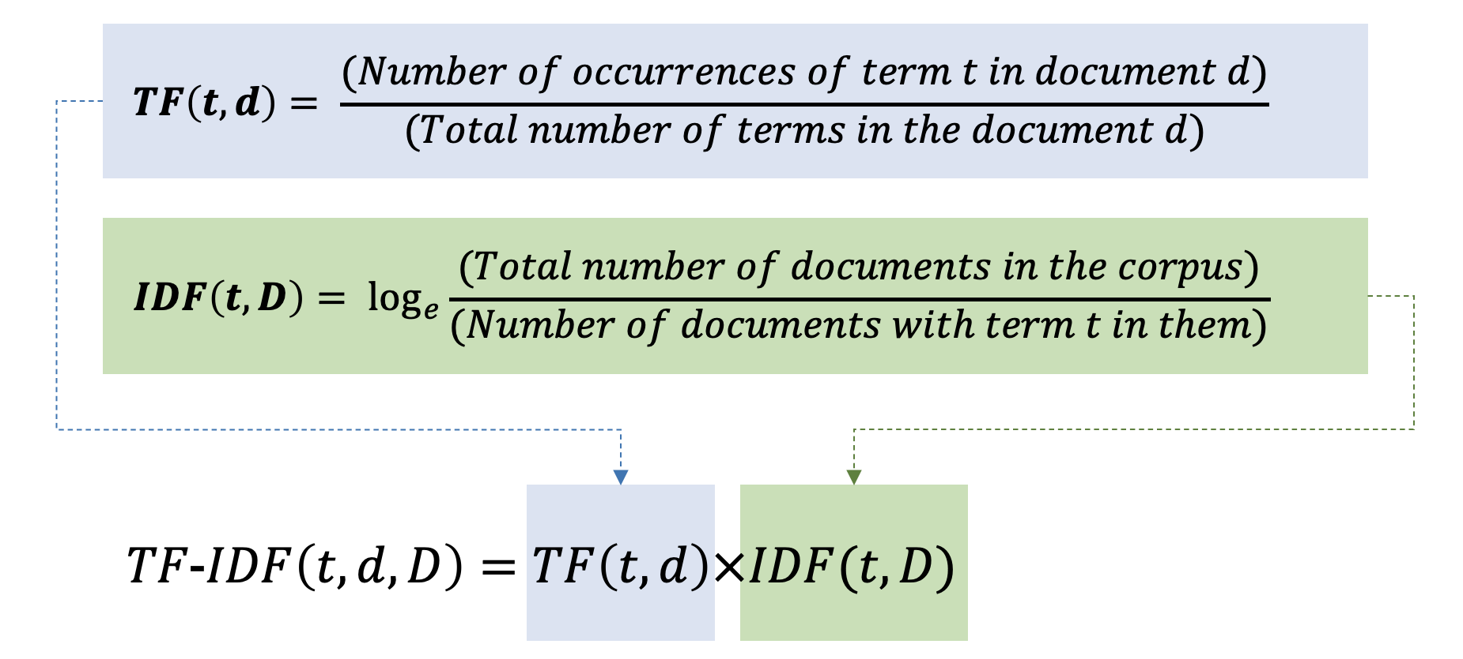
Statistical methods
These methods use statistical techniques to find the most likely answer to a question.
For example:
The question: “What is the capital of France?”
The system: use a term frequency-inverse document frequency (TF-IDF) algorithm to rank the documents that contain the words “capital” and “France” and return the most relevant one as the answer.
Statistical methods:
fast and scalable
they are dependent on the quality and quantity of the data and the features.
https://rfriend.tistory.com/745

Slide 16
Deep Learning methods
The most robust and cutting-edge approach: Deep Learning with Transformer
This method harnesses transformers to fine-tune pre-trained models for building QA systems that operate seamlessly across texts, images, and tables.
This approach holds immense promise for achieving high-quality question-answering performance across a variety of domains and contexts.

